Slide 1
PROJECT TITLE
CAPSTONE PROJECT
Presented By: Edunet Foundation
Student Name : Vighnesh Madankar
College Name & Department : Jain University Bangalore

Slide 2
OUTLINE
Problem Statement
Technology used
Wow factor
End users
Result
Conclusion
Git-hub Link
Future scope

Slide 3
Problem Statement
Insecure communication methods can lead to data breaches and unauthorized access. This project addresses the need for secure message transmission by combining AES encryption with LSB steganography. The system encrypts messages before embedding them into images, ensuring confidentiality and preventing detection. Users can securely hide and extract messages using a simple web interface, enhancing data privacy and security.

Slide 4
Technology used
Backend: Flask (Python) – Handles web requests and application logic.
Frontend: HTML, CSS – Provides the user interface.
Security: AES-256 Encryption (Cryptography library) – Encrypts and decrypts messages securely.
Steganography: Least Significant Bit (LSB) technique – Hides encrypted messages in images.
Libraries:
Pillow (PIL) – Handles image processing.
Flask Flash Messages – Displays success/error notifications.
Cryptography – Implements AES encryption for secure message transmission.

Slide 5
Wow factors
Unique Features of the Project
Dual Security Mechanism – Combines AES-256 encryption with LSB steganography, ensuring both confidentiality and stealth in message transmission.
Invisible Data Hiding – Unlike traditional encryption, which can raise suspicion, this project embeds encrypted messages within images, making detection nearly impossible.
User-Friendly Web Interface – A simple and interactive Flask-based UI allows users to hide and extract messages effortlessly.
Automated Encryption & Decryption – The system automatically encrypts messages before hiding them and decrypts them upon extraction, minimizing user effort.
Cross-Platform Compatibility – Works on any system with a browser, without requiring additional software installations.

Slide 6
End users
Journalists & Activists – Can securely communicate sensitive information without drawing attention.
Cybersecurity Professionals – Can use it for secure data transmission and testing steganography
techniques.
Government & Military Personnel – Ensures confidential communication without detection.
Corporate Users – Can safeguard business secrets and internal communications.
General Users & Privacy Enthusiasts – Individuals who want to protect personal messages from
unauthorized access.

Slide 7
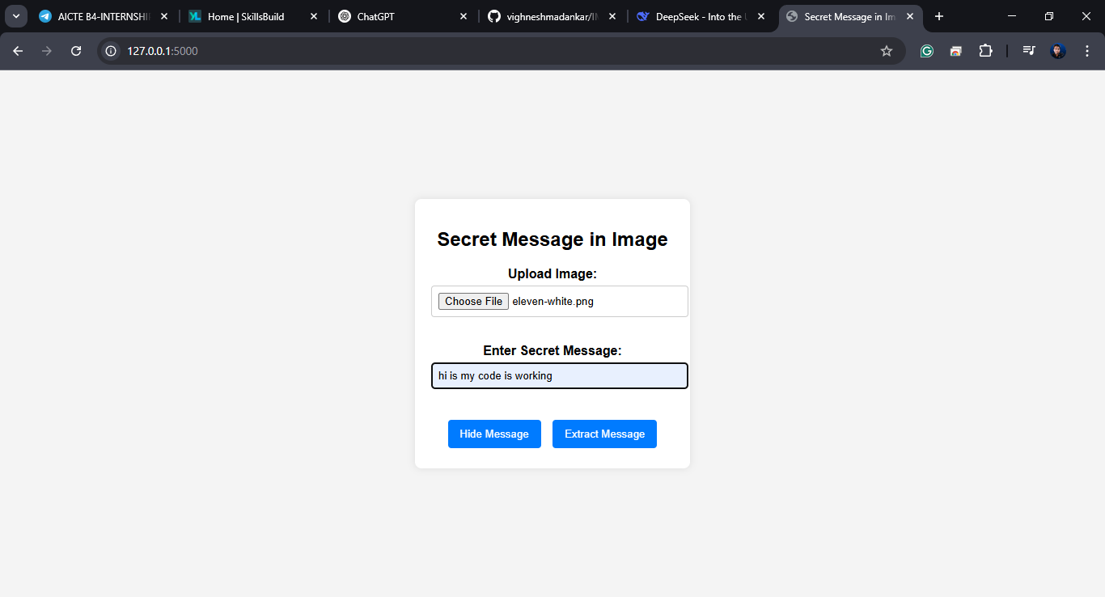
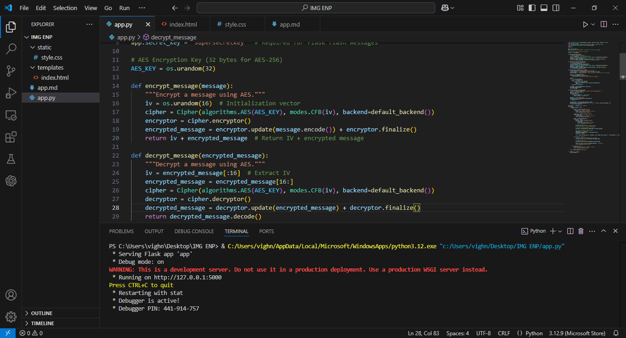
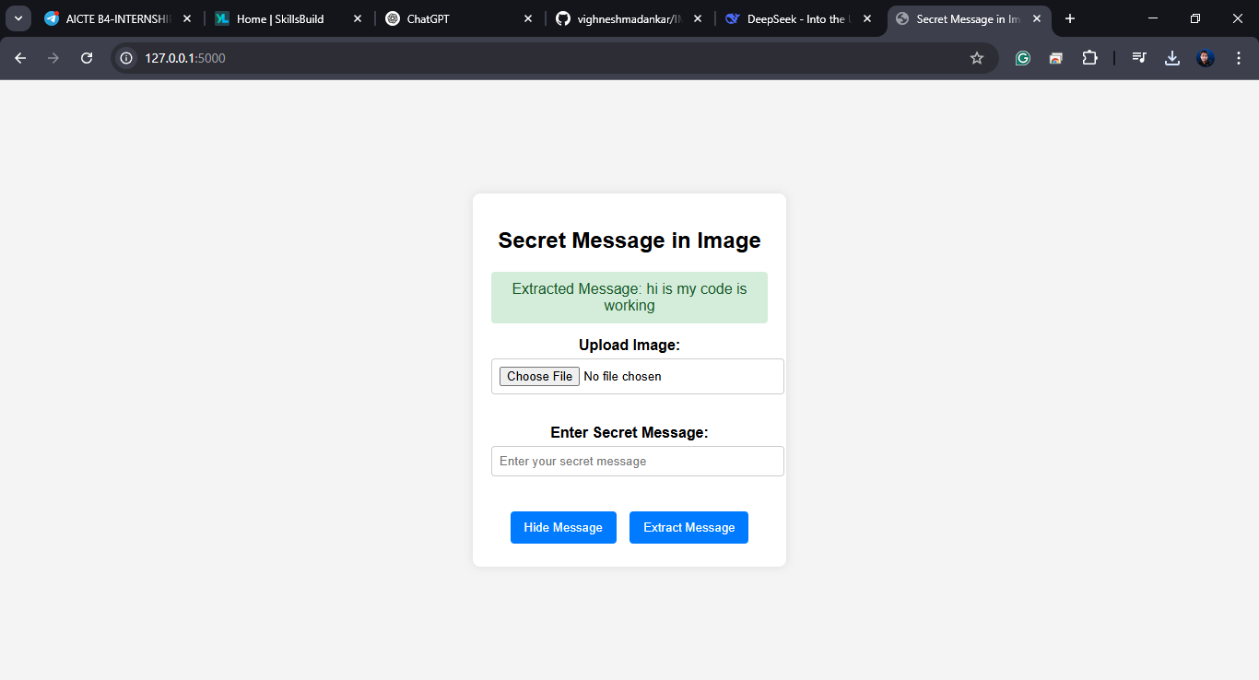
Results
This Is Code Started Webpage
Entering Secret Msg
Here Is Decryption of Msg
This Is Selecting Image For Encryption

Slide 8
Conclusion
This project successfully integrates AES encryption with LSB steganography to provide a secure and covert communication method. By encrypting messages before embedding them into images, it ensures both confidentiality and undetectable. The user-friendly Flask-based web interface makes it accessible for various users, from cybersecurity professionals to privacy-conscious individuals. This solution enhances data security, making it a valuable tool for secure information exchange in an increasingly digital world.

Slide 9
GitHub Link
https://github.com/vighneshmadankar/IMGEN.git

Slide 10
Future scope(optional)

Slide 11
THANK YOU

